Slide 1

Computer Hardware
Processor (CPU)
Memory
Input/Output Devices
Buses
1

Slide 2
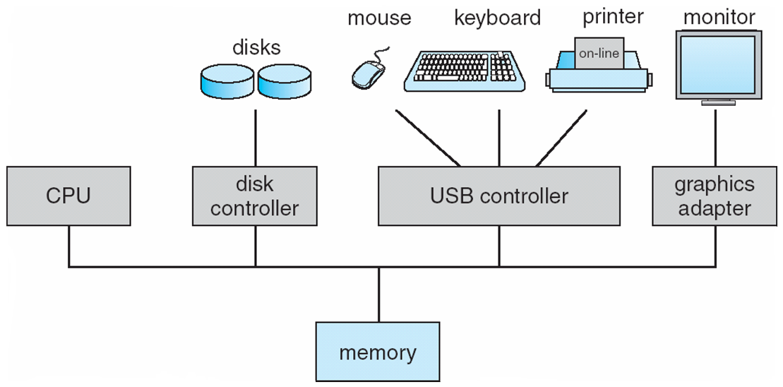
Review of Computer Hardware
OS runs on hardware & must manage it
Model of PC system hardware
2
Notes:
See the following websites for inside the computer:
http://www.computerhope.com/issues/ch000997.htm
http://www.comptechdoc.org/hardware/pc/begin/hwinside.html

Slide 4
Processor Components
ALU – Arithmetic and logic unit
Registers are high-speed memories located on a processor that hold data for immediate use by the processor.

Slide 5
CPU examples
Intel CPUs
Intel Pentium
Intel Celeron
Intel Core
AMD Athlon
Notes:
Multi core chips: 2 or more complete CPUs on the same chip –e.g dual-core and quad- core chips

Slide 6
Processor speed
Processor speed – current processors run at speed of about 3GHz
i.e. 3,000,000,000 cycles per second
Or
The fastest instruction (e.g. moving data from one register to another) executes in 0.3 ns (nanoseconds)
Memory access instructions usually require multiple clock cycles
Notes:
1 ns nsec, a nanosecond is a unit of time representing .000000001 (10⁻⁹) or 1 billionth of a second.
Clock cycle defines when operations are performed in the transistor-level circuitry

Slide 7
Processor - CPU
“brain”
CPU cycle: fetch-decode-execute
CPU has specific instruction set
Pentiums cannot execute SPARC and vice versa
CPU has general registers for local storage
CPU has “special” registers
PC – program counter
IR – instruction register
stack pointer
PSW – Program Status Word
CPU must save the state of all registers for a given process when it is time-multiplexed
7
Notes:
7

Slide 8
Program counter contains
the memory address of the next instruction to be executed
After the instruction has been fetched the program counter is updated to point to next instruction
PSW contains
the mode (user or kernel)
condition code bits, set by comparison instructions
CPU priority
other control bits

Slide 9
Operation of CPU
operation of CPU – simple loop
Instruction is fetched from memory location specified by program counter
Instruction placed in instruction register
9
Notes:
9

Slide 10
10
Program counter is incremented
Instruction is decoded to determine what action to perform
Action is specified by instruction’s operation code
Depending on the operation, one or more operands are fetched from memory

Slide 11
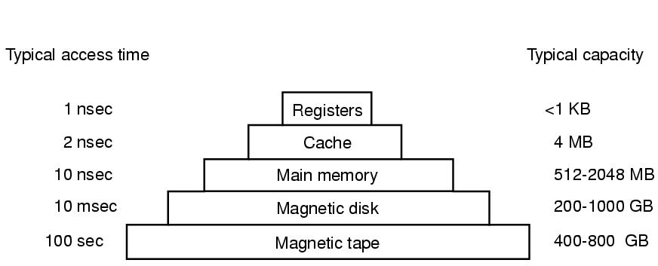
Memory
Ideally very fast, very large & very cheap
not possible so a layered approach is used
Note: magnetic disk (aka hard disk) is called secondary storage
11
Notes:
ns or nsec, a nanosecond is a unit of time representing .000000001 (10⁻⁹) or 1 billionth of a second
A microsecond is a unit of time equal to one millionth (10-6) of a second
A millisecond or ms is one-thousandth of a second.
Current PCs have up to 4 GB memory, 500GB or 1TB hard drive, run at 3GHz (3,000,000,000 cycles per second)
11

Slide 12
Measuring memory etc
The metric units are:
1 Kilo = 1,000 = 10³ (thousand)
1 Mega = 1,000,000 = 10⁶ (million)
1 Giga = 1,000,000,000 = 10⁹ (billion)
1 Tera = 1,000,000,000,000 = 10¹²
1 Milli = 0.001 = 10⁻³
1 Nano = 0.000000001 = 10⁻⁹
These are used for measuring communication lines e.g. LAN runs at 10-Mbps i.e. 10,000,000 bits/sec

Slide 13
But for measuring memory
1 Kilo = 1,024 = 2¹⁰
1 Mega = 1,048,576 = 2²⁰
1 Giga = 1,073,741,824 = 2³⁰
1 Tera = 2⁴⁰
e.g. a 1 GB memory contains 1,073,741,824 (2³⁰) bytes

Slide 14
Memory
14
Registers - programs must manage them
Cache - controlled by cache hardware
various “levels” - high-speed cache located closest to CPU
if “cache hit” occurs significant time is saved
Main Memory - RAM
Secondary Storage - Magnetic Disk - HD
mechanical device, much slower than RAM
Magnetic Tape - Backup, removable

Slide 15
Other Kinds of PC Memory
ROM - preprogrammed, non-volatile
bootstrap loader held here - ROM BIOS
Some I/O cards have ROM for low-level routines to read keyboard, write to screen
MAC addresses on NICs held in ROM
EEPROM/Flash RAM - rewritable memory
non-volatile, updateable by OS through s/w
E.g. USB key, memory for digital cameras
CMOS - volatile
stores system date/time, which disk to boot from
powered by small “CMOS” battery
15
Notes:
15
The MAC address (Media Access Control) is a unique value associated with a network adapter. MAC addresses are also known as hardware addresses or physical addresses. They uniquely identify an adapter on a LAN.
To find the MAC address of your computer: Click on the connection icon in the system tray. It may look like a small graphic, or like a tiny computer monitor. After clicking on it, select "Open Network and Sharing Center".
NIC – network interface card/controller
Flash memory is an electronic non-volatile computer storage medium that can be electrically erased and reprogrammed.

Slide 16
Input/Output Devices
I/O devices consist of controller + device itself
controller is a chip(s) on PCB that physically controls the device
accepts commands from OS + executes them
controller presents simpler interface to OS
devices have fairly simple interfaces in order to make them standard
standard interfaces => any IDE disk controller can handle any IDE disk
actual device interface “hidden” from OS which only “sees” the controller interface
16

Slide 17
Input/Output Devices
Software used to “talk” to controller is device driver
Controller vendors must supply driver for each OS it supports
scanners, printers, HDD etc. typically come with drivers for various OS
driver must become “part” of the OS so it can run in kernel mode
This can require the OS to reboot so that it can find and load the driver
For hot pluggable devices such as USB, driver is installed on-the-fly without need to reboot
17
Notes:
17
Hot pluggable devices e.g. USB and IEEE1394 need dynamically loaded drivers
The first time you connect a device that plugs into a USB port, Windows automatically identifies the device and installs a driver for that device.
Before plug and play, every I/O card had fixed IRQ level and fixed addresses for its I/O registers
With plug and play, system automatically collects info about I/O devices and centrally assign IRQ levels and I/O addesses
An IRQ is an Interrupt ReQuest

Slide 18
Performing Input/Output
3 ways are possible
busy waiting
Interrupts
Direct Memory Access
18

Slide 19
Performing Input/Output busy waiting
19
user program has an i/o statement
e.g read(file, buffer,n)
When executed, this will generate a system (OS) call
Control is passed to kernel
kernel translates the system call into a procedure call to the appropriate driver.
Driver starts I/O and then continuously checks the device to see if it is done (called “polling” the device).

Slide 20
Performing Input/Output busy waiting (continued)
When done, driver puts data where they are needed and returns
OS then returns control to the caller (user-program)
Problem is that CPU is tied up polling the device
Most I/O devices are much slower than the processor so there can be quite a delay

Slide 21
Performing Input/Output interrupts
Interrupts provide a means of performing I/O whereby CPU is not tied up awaiting completion of I/O
Thus interrupts improve processor utilisation
21
Notes:
Interrupts are provided primarily as a way to improve processor utilization
Most I/O devices are much slower than the processor

Slide 22
Performing Input/Output interrupts (continued)
Interrupts:
As for busy waiting, driver starts i/o, asks device to give interrupt when ready
driver returns, OS then blocks caller and does other work
When device controller detects end of transfer it generates an interrupt to signal completion
Interrupt controller gets this signal and if it accepts it, informs the CPU, putting the device number on the bus so the CPU can read it

Slide 23
Performing Input/Output interrupts (continued)
The CPU senses the interrupt-request line after executing every instruction
CPU consults its interrupt vector to find the interrupt handler for the device (part of driver software).
Handler will copy data to memory space of user program (if the user program issued an input request)
When handler completes, the user program will change state from blocked to ready
The scheduler (part of OS) decides which process will run next

Slide 24
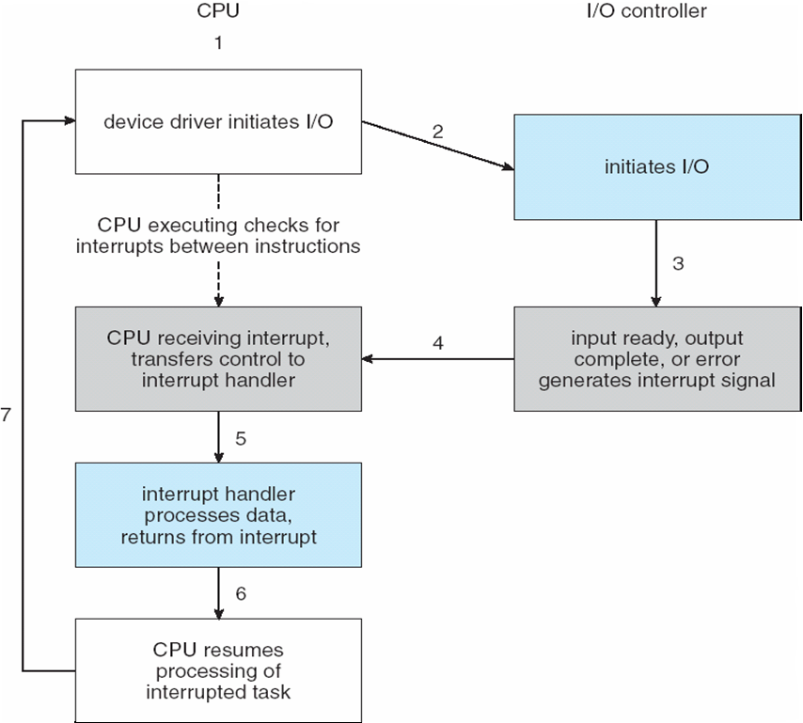
Interrupt-Driven I/O Cycle
Notes:
24
At 6, interrupted process may be put in ready queue. Scheduler chooses the next process to run e.g. the I/O completion may have been for a process with a higher priority than the currently executing one – so this higher priority process may now run

Slide 25
Performing Input/Output Direct memory Access
special chip capable of controlling flow of bits between memory and controller without constant CPU intervention
CPU sets up DMA chip, telling it how many bytes to transfer, device & memory addresses involved
When DMA chip done, it generates interrupt, handled as before
As interrupts can happen anytime, CPU has a way of temporarily disabling interrupts and re-enabling them later. Interrupt controller decides which interrupt occurs next - based on static priorities.
25

Slide 26
Buses
26
A bus transports information between hardware devices
All buses have different transfer rates
ISA and PCI the main two bus types
IBM ISA for backward compatibility with older/slower cards, 16-bit, 16.67MB/s
Intel PCI used for new cards, 64-bit, 528MB/s
IDE/ATA bus for hard drives and CDROM drives
USB devices all share same USB device driver
a root device polls devices for traffic every 1ms
SCSI: used for fast disks - 160MB/s

Slide 27
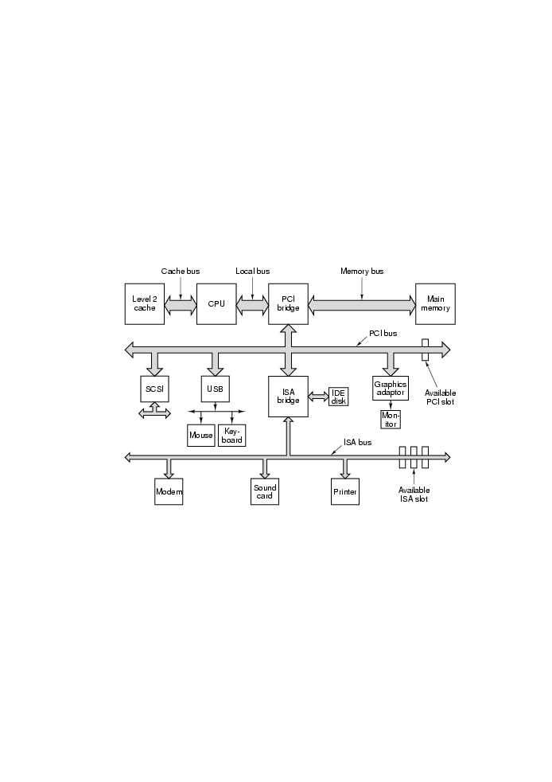
27
Notes:
A large Pentium looks like this
This system has 8 buses – cache, local, memory, PCI, SCSI, USB, IDE, ISA
27

Slide 28
Peripheral Devices and ports
Peripheral devices are attached to computers via ports
A port is a bus that connects exactly two devices
Serial ports – transfer data one bit a time.
Mice, keyboards
Parallel ports – transfer data several bits a time.
Printers
USB ports – Transfer data at a fast speed.
480Mbit per second (USB 2.0)
External disk drives, digital cameral, printers
28
Notes:
USB – universal serial bus. All USB devices share a single USB device driver – so it is unnecessary to install a new driver for each new USB device. First time a USB device is used, Windows will dynamically load a driver.
Thus can add a USB device without needing to reboot.

Slide 29
Plug and Play
OS must manage and configure all devices
conflicts were common between preset IRQs
Then Microsoft/Intel developed “plug & play”
This allows OS to configure and use newly installed hardware without user interaction
OS collects data about I/O devices, centrally assigns IRQ and I/O addresses and tells cards this info
29
Notes:
IRQ – interrupt request level
Before plug and play, every I/O card had fixed IRQ level and fixed addresses for its I/O registers
Then adding a new device to your PC was a huge ordeal. Dip switches and jumpers had to be fiddled with in trial and error attempts.
With plug and play, system automatically collects info about I/O devices and centrally assign IRQ levels and I/O addesses
See http://www.helpwithpcs.com/upgrading/change-irq-settings.htm for IRQ and how to view your system’s current IRQ assignments

Slide 30
Boot-up process
Computer boots,
BIOS starts (Basic Input Output System)
checks how much RAM available, whether keyboard & other devices are installed/working
scans ISA/PCI buses, detecting devices attached
legacy devices will be found to have fixed IRQ/I/O addresses
plug&play devices recorded
any new devices are now configured
determines boot device by trying list of devices stored in CMOS (list changeable through BIOS config program, accessible after booting)
30
Notes:
To go to BIOS, press F2 key as system boots up. Can then see boot sequence etc.
30

Slide 31
Boot-up Process
Floppy Disk, CD-ROM, HD are tried normally
1st sector from boot device read into memory and executed
this sector has program that checks partition table at end of boot sector to see which partition is active
then secondary boot loader read in from that partition which reads in the OS from active partition and starts it.
OS queries BIOS to get config info
checks if it has device driver for each device
31

Slide 32
Boot-up Process
32
If driver is missing, OS asks user to insert floppy or CDROM containing driver
Once OS has driver, OS loads it into kernel
Then OS creates any background processes necessary and (usually) launches GUI
Users starts working with system

Slide 33
33
Will now begin looking in detail at how operating systems work
Basic concept on which all operating systems are built are:
Processes and threads
Memory management
I/O management
File system
Security

